Slide 1
Hello!
My name is XXXXXX

Slide 2
Bullying

Slide 3
Can anyone tell me what types of bullying there are?

Slide 4
Physical
Verbal
Emotional
Cyber
Notes:
Physical
Hitting, kicking and spitting or
tripping someone up
Damaging people property, homes etc.
Stealing someone’s belongings etc..
Verbal
Name calling
Insulting someone’s family
Making threats
Spreading rumours
Constantly putting someone down
Emotional
Excluding someone from a group or a game
Humiliating someone
Cyber
Bullying someone by
Text, Email, IM, chatrooms on the internet
Cyber Bullying is against the law.
Malicious communications act 1988

Slide 5
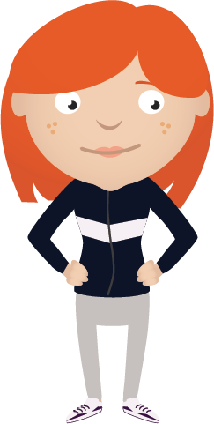
Bullying is…
when these things happen again and again and the person bullying has power over the person they are bullying.

Slide 6
How does being bullied make you feel?
Happy
Sad
Angry
Embarrassed
Scared

Slide 7
Frightened and scared
Nervous
Believe what is being said is true
Depressed
Angry
Confused
Defensive

Slide 8
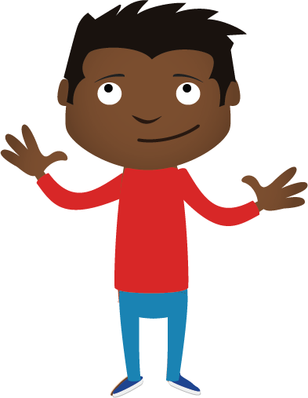
We are all different in many ways:
Eye colour, hair colour, gender, likes and dislikes, favourite foods, TV programmes or films we enjoy, hobbies, clothes, family members, beliefs and cultures.

Slide 9
Being different makes us special and an individual, it makes the world a more interesting place to live.

Slide 10
We all have the right to feel safe all of the time and we can talk with someone about anything.

Slide 11
Let’s talk about online bullying

Slide 12
Sometimes people can say nasty things online because they think they will not be found out.
Think, have you ever said anything bad online.
This is called cyber bullying.

Slide 13
Think, would you like your mum or dad, gran or teacher like the things you are putting online.
If not, then don’t do it.
Be an online hero.

Slide 14
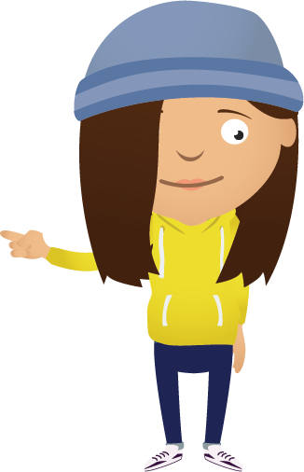
You should not feel alone or ashamed if you are being bullied. It is not your fault, but it is very important that you ask for help.

Slide 15
The sooner you talk to someone about it the sooner it can be stopped.

Slide 16
Who could you talk to if you were being bullied?

Slide 17
My teacher
My parents or carers
My grandparents
My cub leader

Slide 18
Remember we talked about how being bullied felt…

Slide 19
…if you saw someone being bullied, what could you do to help?

Slide 20
If you see someone on their own at school go and talk to them, invite them to sit or play with you and your group of friends.
Notes:
Don’t leave people out.
Try and include everyone in what you are doing, make them feel a part of it.

Slide 21
If you see someone who is being bullied, tell someone so they can stop the bullying.

Slide 22
…and if you are being bullied…

Slide 23
S
Say how you feel
A
Ask for help
F
Find a friend
E
Exit the area

Slide 24
Remember, we all have the right to feel safe all of the time and we can talk with someone about anything.

Slide 25

Help
Teachers
Childline
Family
Trusted adult

Slide 26
What have we learned today?

