Slide 1
Hello!
My name is XXXXXX

Slide 2
Staying safe online

Slide 3








Notes:
Use this slide to engage the children and to find out what they enjoy doing online
Games – Fortnite, Roblox, slither.io
Google, Tik Tok (Musical.ly), YouTube
Social media and messaging – Instagram, WhatsApp, Snapchat, Skype
If anything inappropriate is mentioned, you need to decide whether to deal with this now or at a later stage in the presentation

Slide 4
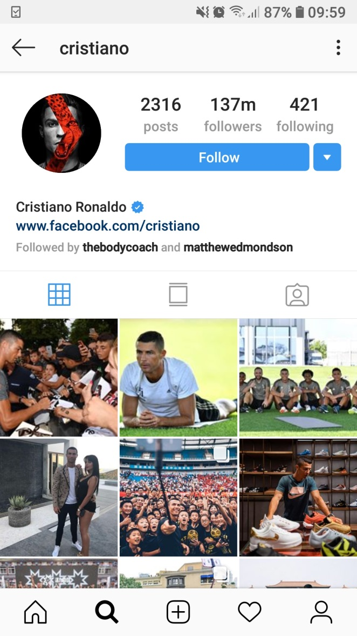
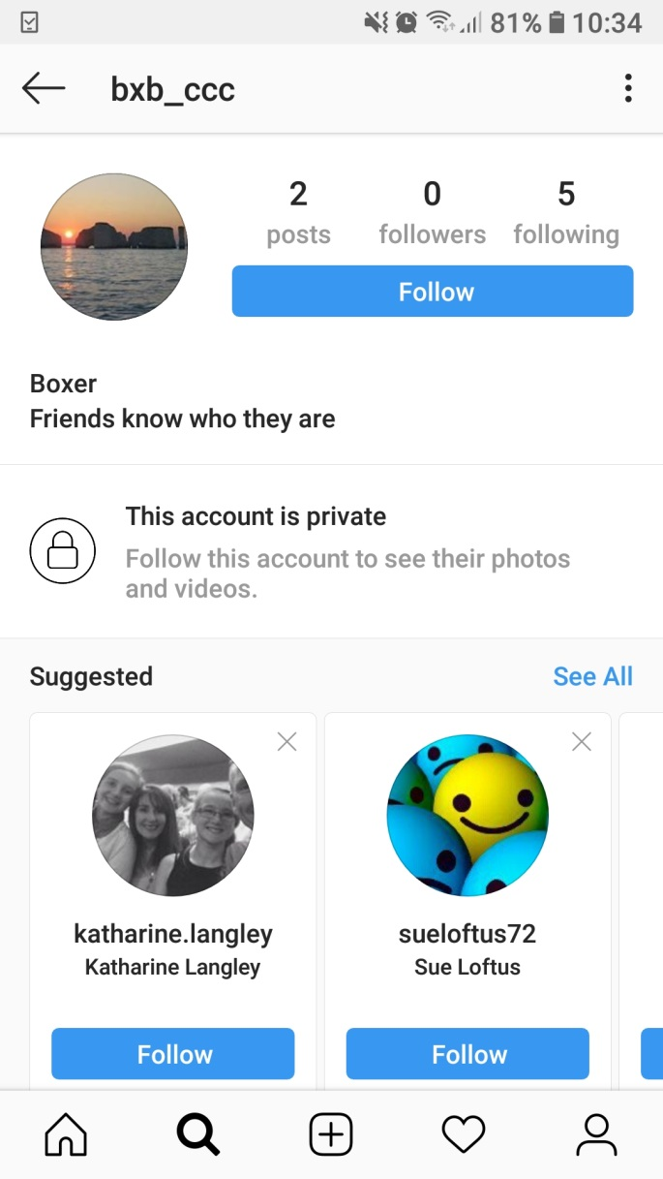
Which profile
is better?
Notes:
Know them, trust them, they are kind to us
Ask about playing games with friends
What do we call a person we don’t know – STRANGER
Talk about playing games or chatting online
It is safest to play games with people who are already friends – not Strangers

Slide 5
You post a picture of all your school friends on your Instagram – what are the risks?
Notes:
Tells people who your friends are; if in uniform tells people approximately where you live
There may be people in your group of friends who do not want to be online, or are not allowed to post pics online or for whom it is dangerous
Always get permission to put images of yourself online – compare with schools that have to get parental permission to use images of the young people

Slide 6
In a class group chat, one person says to another person:
Everybody hates you, why don’t you just leave the group?
Is this bullying?
Notes:
Debate the points about: one-off vs ongoing, difference online – more people can see, people can comment/like, 24/7, is it banter/someone trying to be funny
Get the children to think about good and bad things relating to group chat
Good for chatting with friends – checking on homework – sharing funny stuff
Bad – someone can often add a person no one else knows, things get out of hand quickly, don’t have facial/body language cues that you would get face to face
Ask how can group chat be kept positive – use emojis, only say nice things to people, don’t retaliate
Ask what the young people think someone should do if they get a horrible comment? Note that many will be aware that if friendship issue, it will often sort itself out but that if bullying they may need help from an adult

Slide 7
What are the risks of online gaming?
Notes:
Content: If this is a game for older people – you will probably see inappropriate content and hear inappropriate language – talk about PEGI ratings. If you have younger brothers and sisters, you should play games suitable for them
Who are you playing with? Even if you know everyone in the group from school – bullying can still occur or people fall out . If you are playing a game with chat you may need to switch it off. Know how to block/report
If you don’t know people – bullying, grooming, radicalisation – if you don’t know people you have no idea what they will do. Adults may not want to play with kids and can be unpleasant
Particular issues if you are using a headset to chat in real time - people may try to trick you into saying or sharing information or ask you for photos/videos
In app purchases – games may be free but there is pressure to buy features to help you move up the levels or access different equipment in the game – eg Fortnite Battlepass
Addiction – games and other online platforms are designed to keep you on there for as long as possible. Need to have a break and do something else
Recommend they only play online with people they know so if there is a problem it can be sorted

Slide 8
My mum says too much time online is unhealthy – how much is too much?
Notes:
Ask the young people how they would know if they were spending too long online?
Some screentime can be beneficial but there are issues. Some questions to ask themselves might be
Do I know how much time I spend every day including gaming, messaging, watching videos etc?
If I can’t get online, does it make me feel bad?
Do I get angry or upset when I’m asked to stop going online, even if I’ve been at it for hours?
Is be online pretty much all I talk about and think about?
Am I letting other things slide like my schoolwork or spending time with friends in real life or not doing other activities?
If I spend a lot of time looking at social media does it make me feel worse about myself?

Slide 9
Notes:
Get account settings on private; approve friends/followers; be careful what you share
Don’t put other people at risk
Take care gaming; don’t chat with/message strangers
Be kind to each other
Balance your online and offline activities
Tell a trusted adult if there are any problems

Slide 10
What have we learned today?

