Slide 1
We all have the right to feel safe all of the time and we can talk with someone about anything.

Slide 2
Hello!
My name is XXXXXX

Slide 3
My feelings and me

Slide 4
How do you feel right now?
Happy
Sad
Angry
Embarrassed
Scared

Slide 5
How would you feel doing this?
Happy
Sad
Angry
Embarrassed
Scared

Slide 6
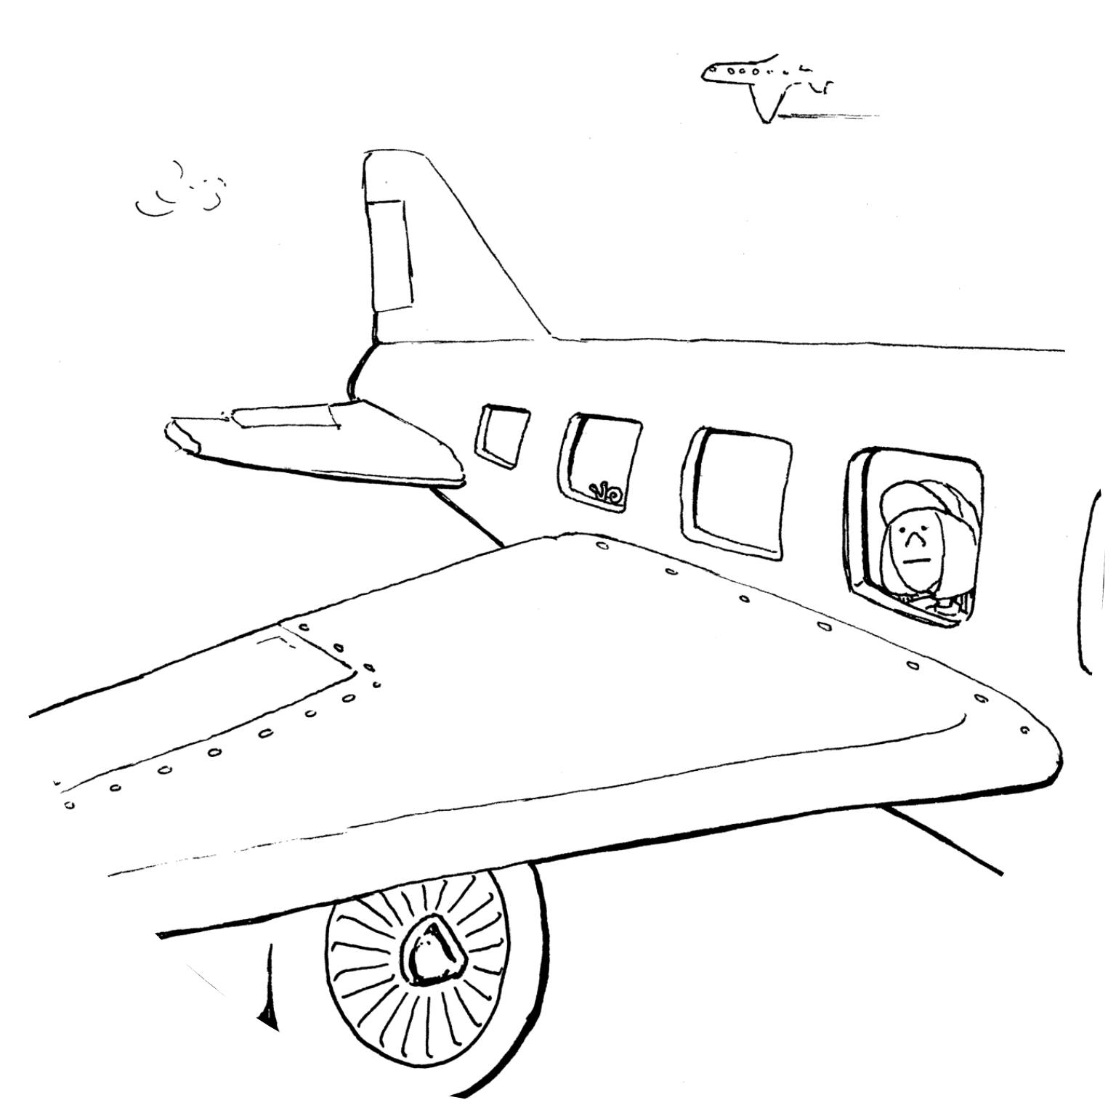
Flying on
a plane

Slide 7
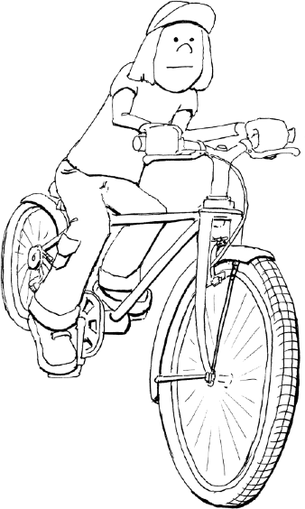
Riding a bike

Slide 8
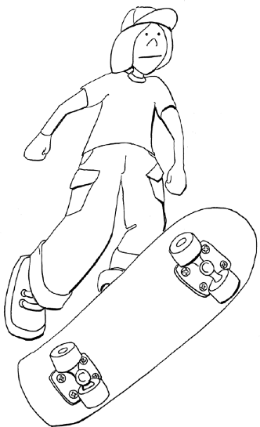
Riding a skateboard

Slide 9
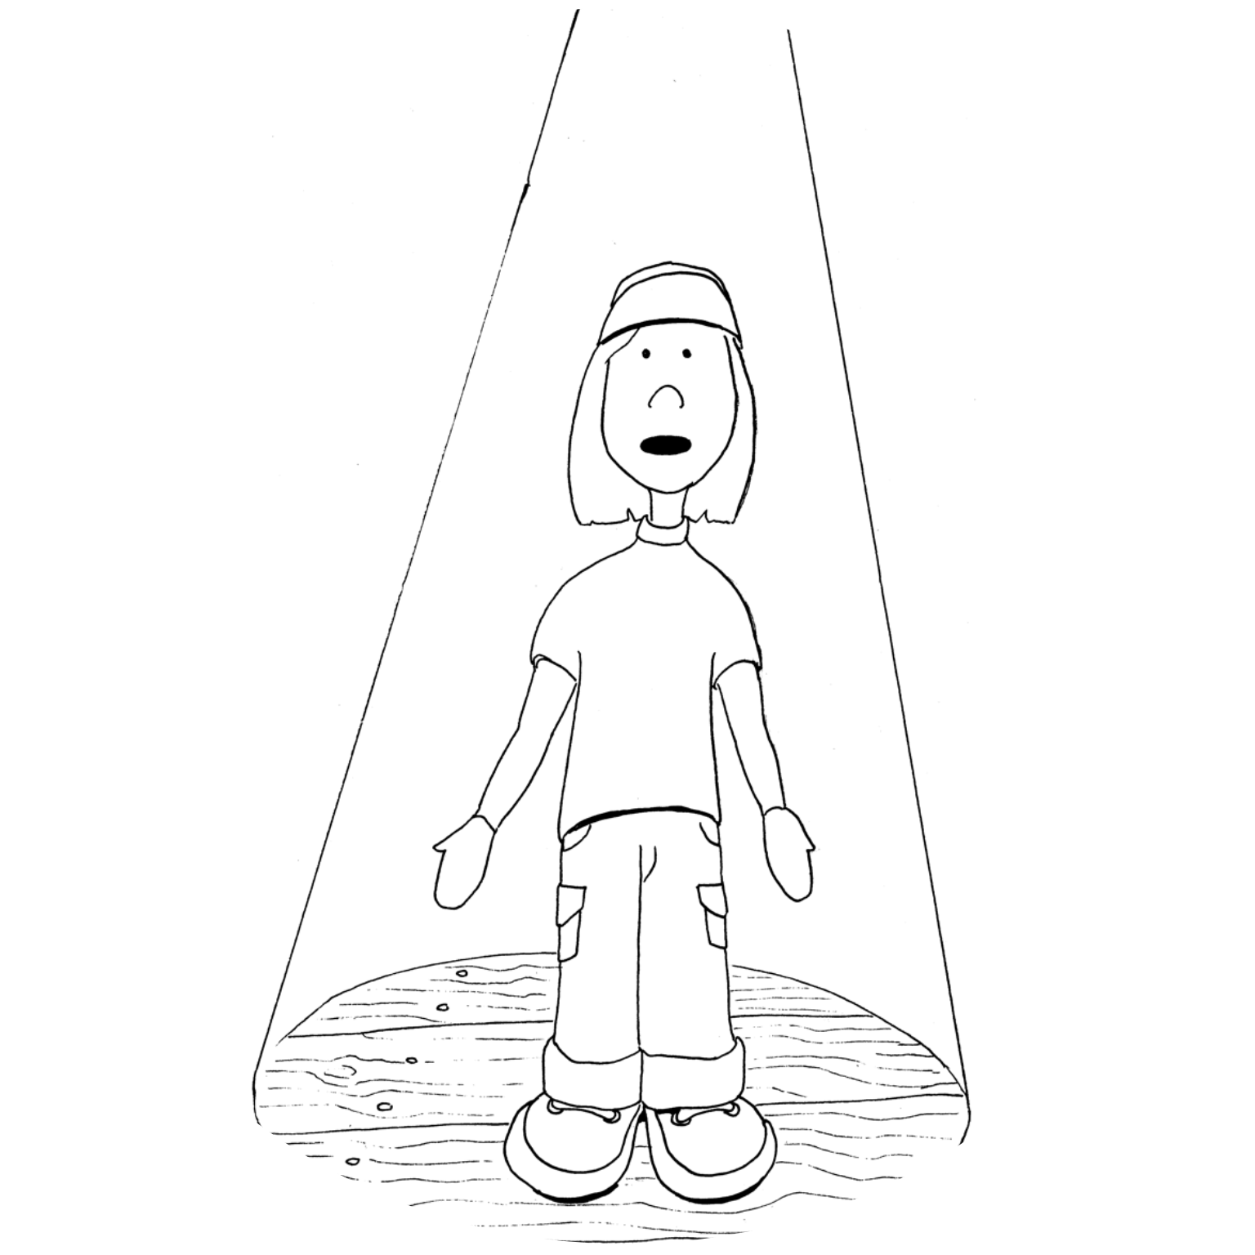
Singing to a crowd

Slide 10
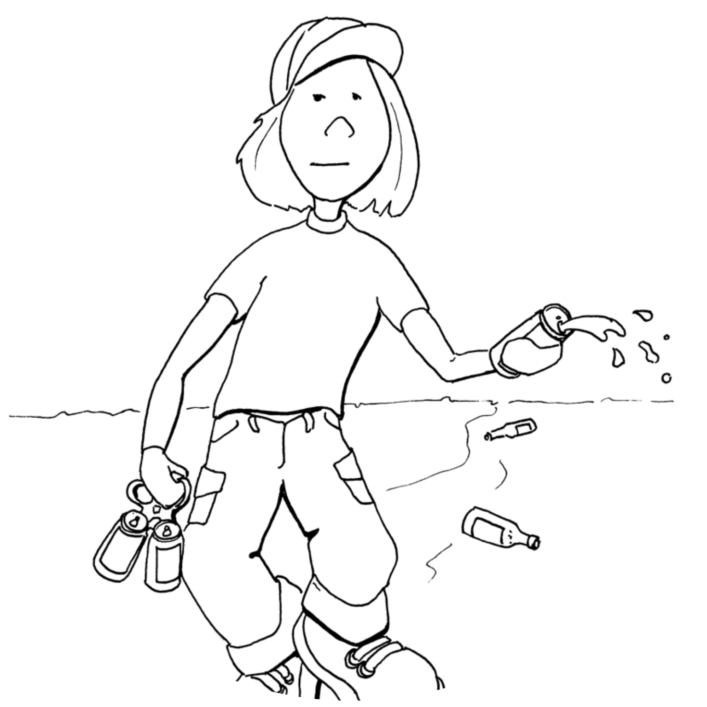
Someone being drunk and noisy

Slide 11
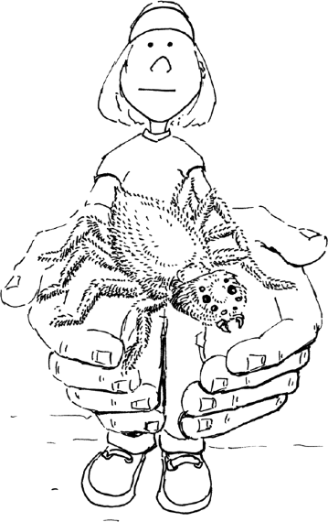
Holding a
spider

Slide 12
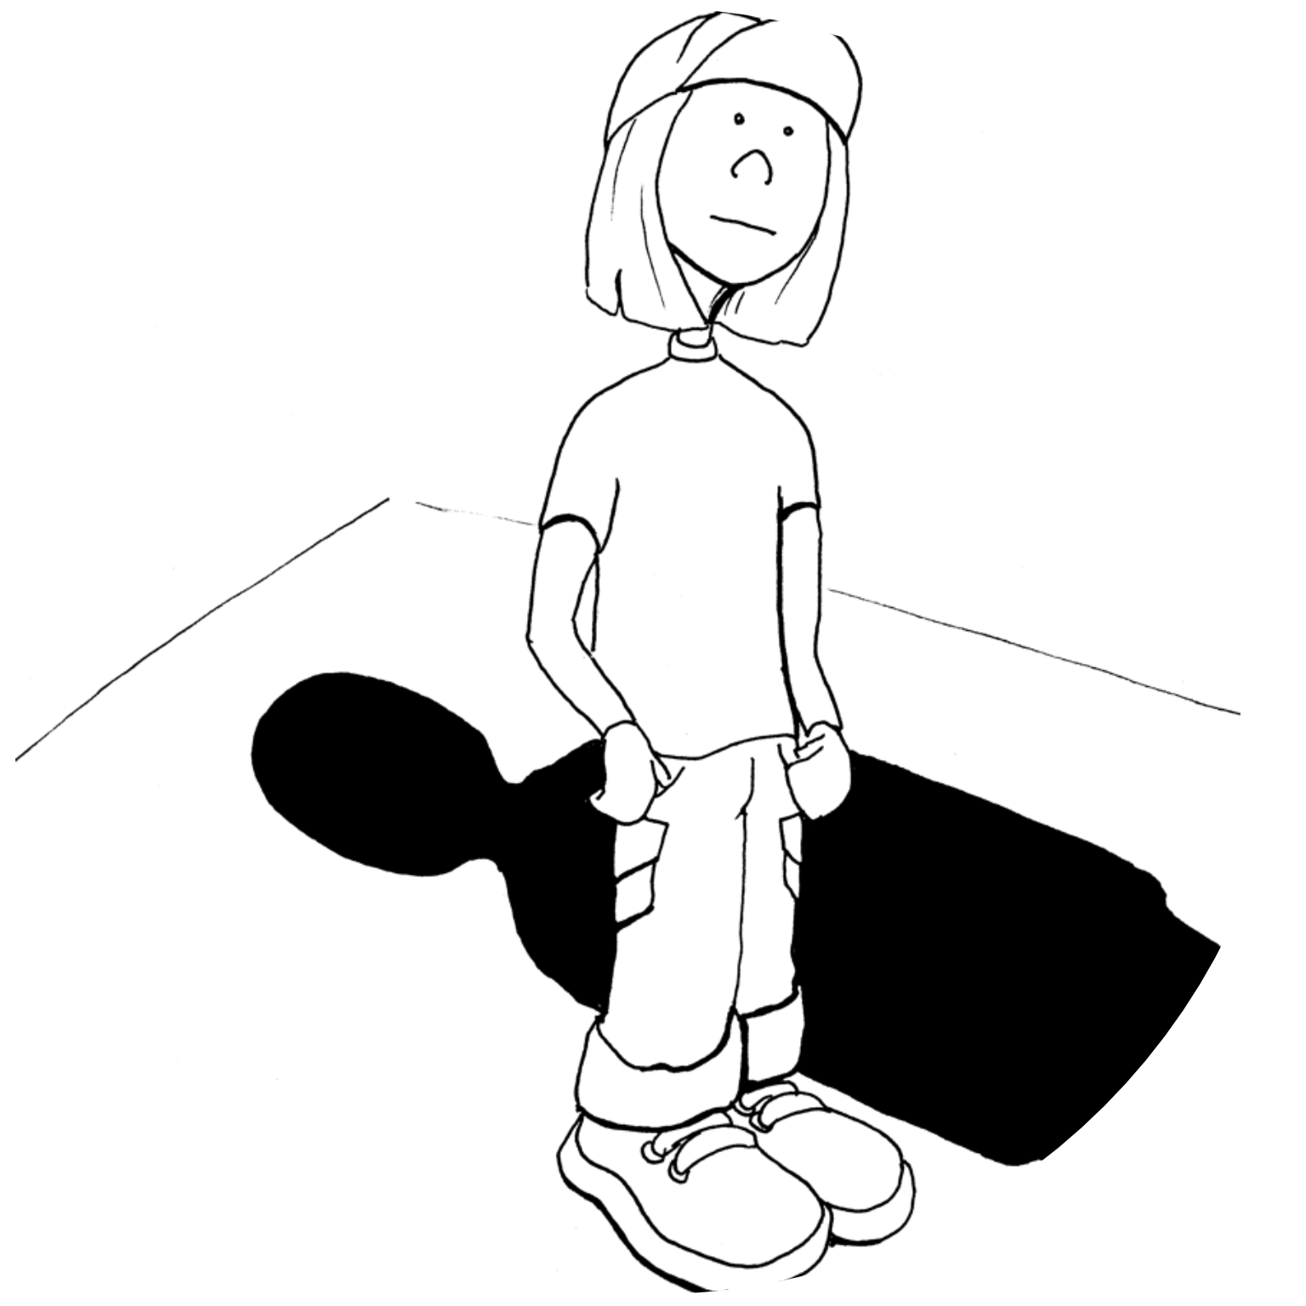
A stranger talking to you in the street.

Slide 13
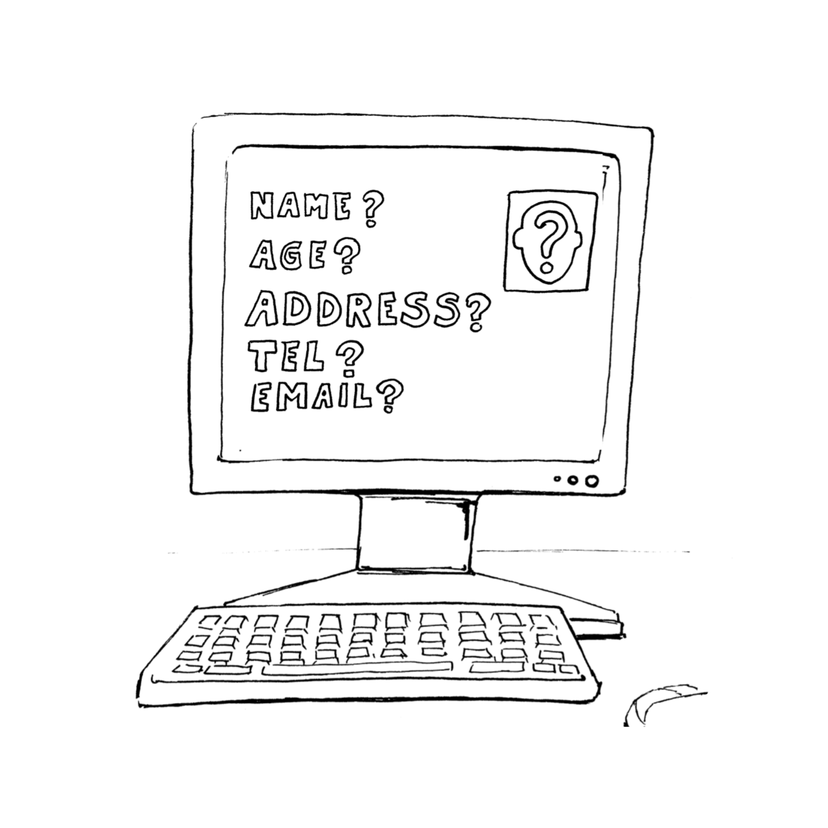
Giving someone your personal information online

Slide 14
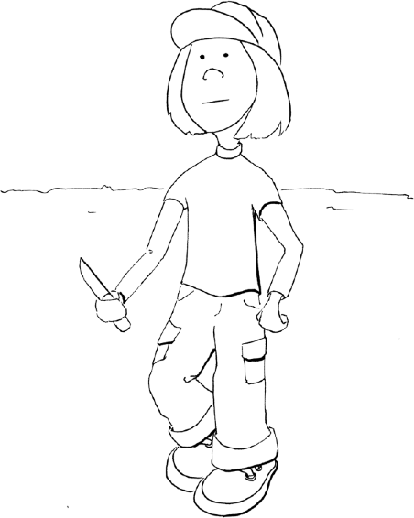
Someone carrying a knife

Slide 15
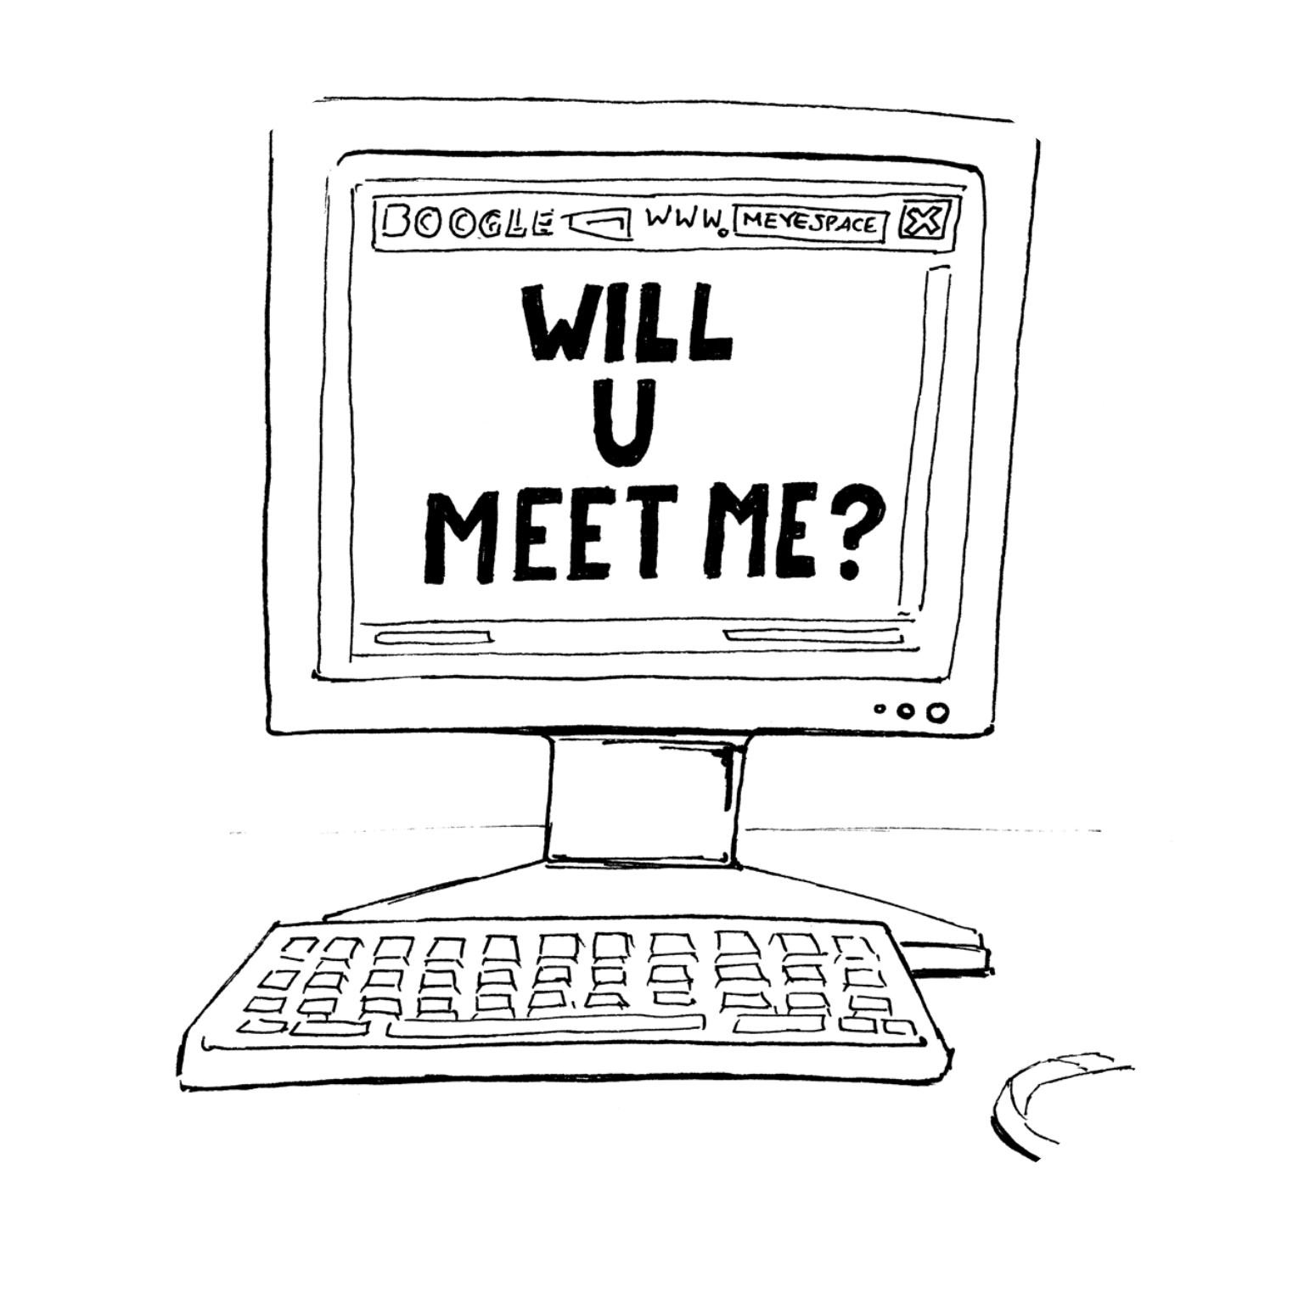
Someone online saying they wanted to meet you

Slide 16
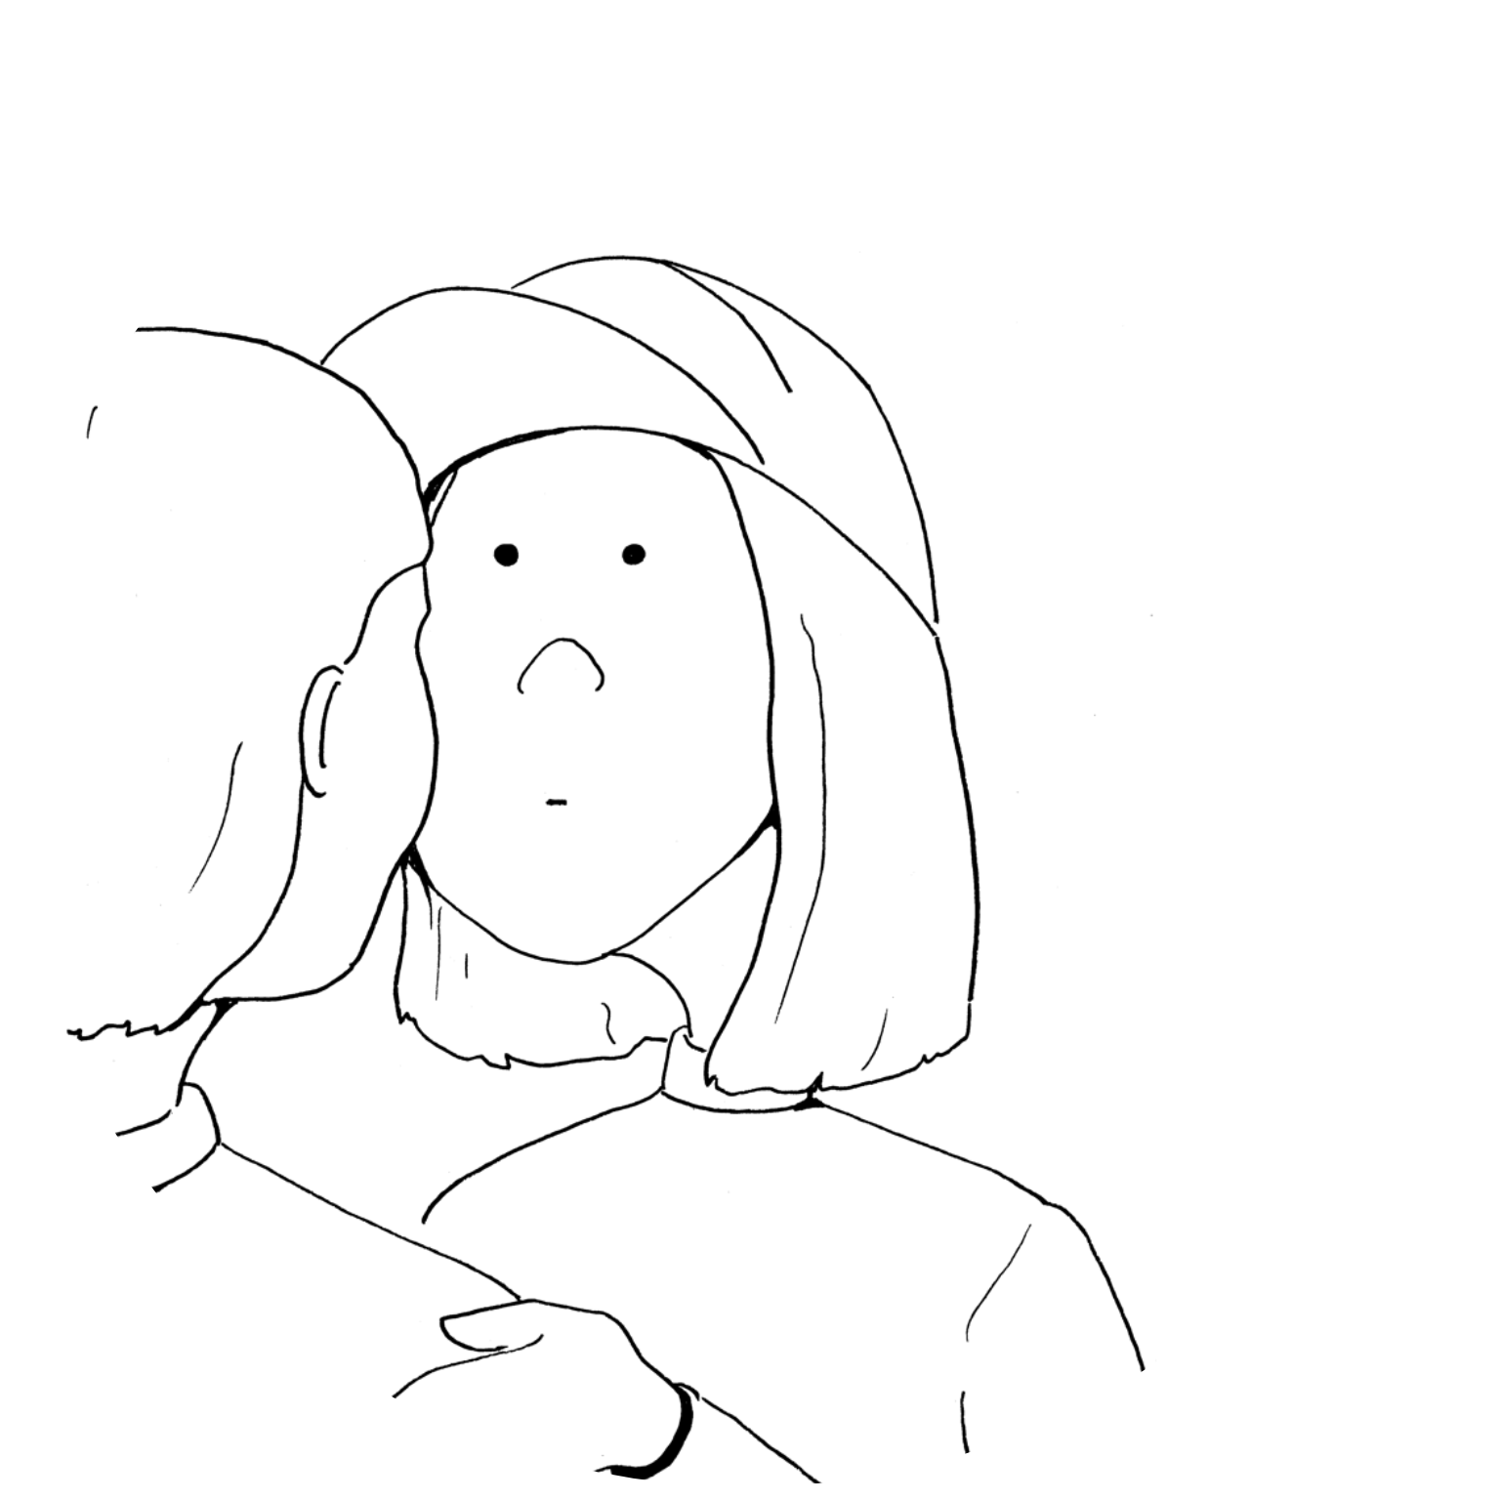
Someone wanting to cuddle you when you don’t want them to

Slide 17
Our bodies are amazing and give us signs when we are worried.

Slide 18
What does your body do when you feel unsafe?

Slide 19
Hairs on the back of my neck
I feel like my hair is standing up
I don’t want to eat
I feel sweaty
I can’t concentrate
I want to cry
Butterflies in my tummy
My heart beats faster
I feel shaky allover
My legs feel wobbly
Goose bumps
Feel like in I need to go to the toilet
I feel sick

Slide 20
Who could you talk to when you feel unsafe?

Slide 21
My teacher
My parents or carers
My grandparents
My cub leader

Slide 22
I should never have to keep a secret that makes me feel bad or uncomfortable.

Slide 23
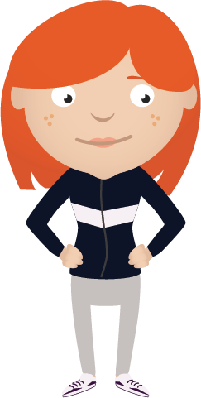
My body is my body and it belongs to me.

Slide 24
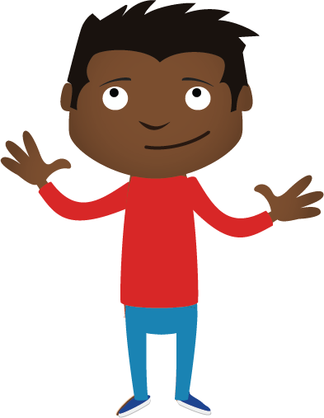
My private parts are the parts of my body under my bathing suit.
No one can touch my private parts.
No one can ask me to touch their
private parts.
No one should show me pictures of private parts.

Slide 25
Help
Teachers
Childline
Family
Police

Slide 26
What have we learned today?

