Slide 1
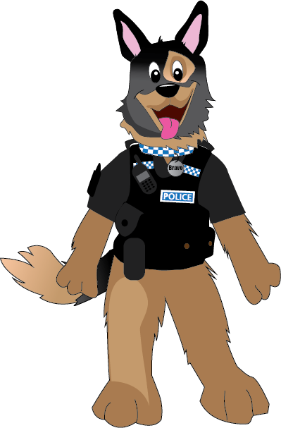

Weapons

Slide 2
What is a weapon?

Slide 3
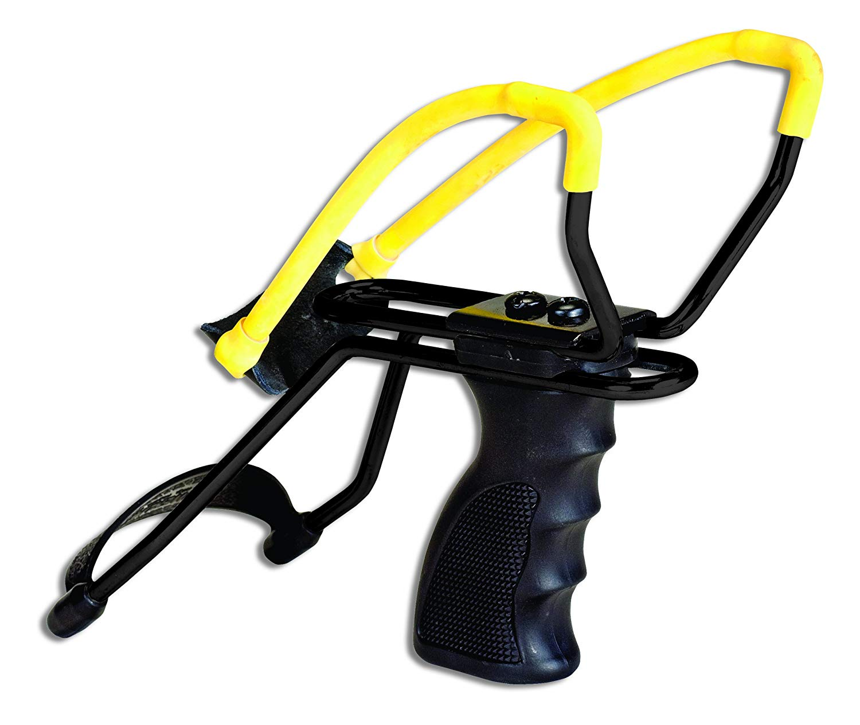
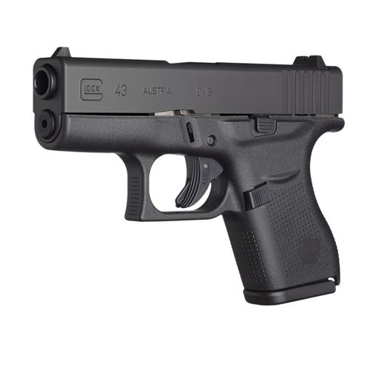
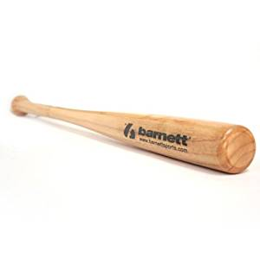
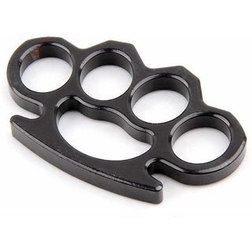
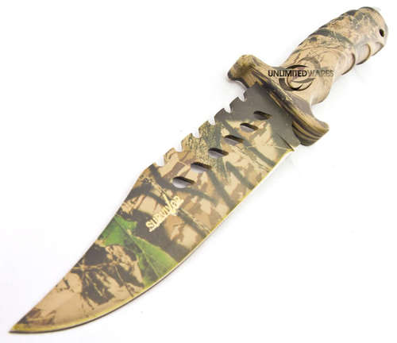

Slide 4
Can you tell the difference between a real or fake gun?
Fake
Real

Slide 5
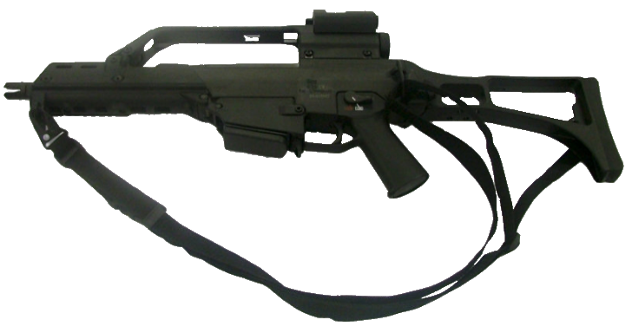
Fake

Slide 6
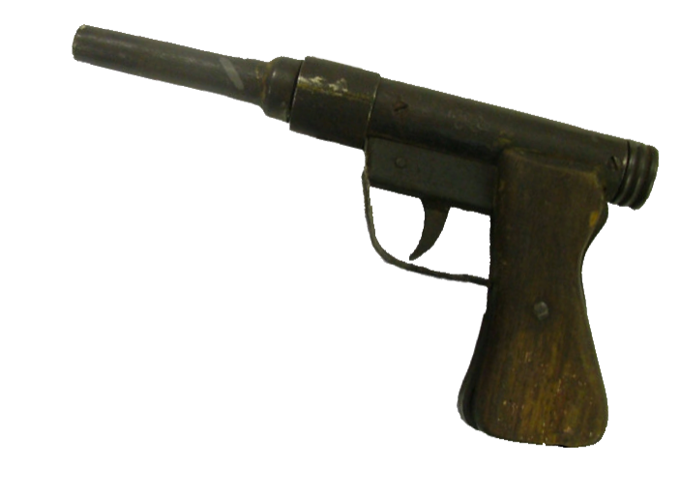
Real

Slide 7
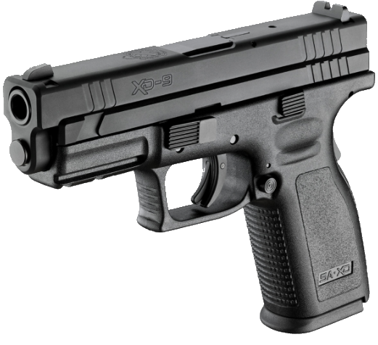
Real

Slide 8
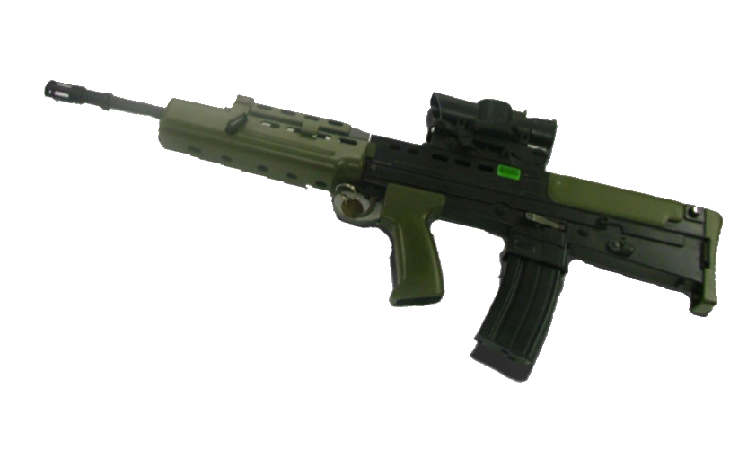
Fake

Slide 9
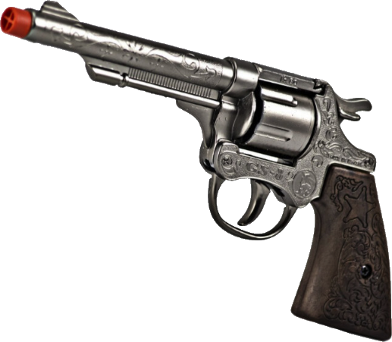
Fake

Slide 10
Real

Slide 11
How near would a person need to be to tell if a weapon is real or fake?

Slide 12
Put your hands up if you know someone with a
BB gun?

Slide 13
It is against the law for anyone to have any weapon in a public place without good reason.

Slide 14
Knives

Slide 15
True or false,
it is against the law to carry
a knife in a school.
True
School staff can legally search
pupils for knives

Slide 16
What will happen if you are found with any weapon?

Slide 17
You risk being arrested
You will be interviewed by the police
You will be dealt with.
Your details will be put on
police systems

Slide 18
Don't do something you will you’ll regret for the rest of your life...

Slide 19



Help and support
Trusted adult

