Slide 1


Slide 2
Online Safety for Parents

Slide 3

Another world
Don’t let your
lack of knowledge
stop you engaging
Notes:
Lots of parents feel they are unable to talk about online safety or the internet with their kids because they don’t understand it themselves. Yes, the internet is complex and comes with some risks, but it is also a positive environment for young people to explore.

Slide 4
We’re all connected!
Notes:
All these devices connect to the internet
Consoles
Smart phones
PCs/Laptops
Smart speakers
E readers
Fridge freezers (Well the smart ones!)

Slide 5
Talk to your children
Notes:
You can only find out about things by engaging.
Remember there was a time when you didn’t know what ‘In the Night garden was’?!

Slide 6






Look what I’m playing!
18
Notes:
Who has heard of these games/apps?
How many of you have actually sat down with your children and played/used them together?
Which of these games let you play online and communicate with strangers, all of them!
GTA5, this game is several years old but still very relevant: Age 18+, Includes torture, sex, bad language, drug use, stereotyping, poor view of women etc

Slide 7


Notes:
Shops cannot sell games to children below the PEGI age rating eg. Cannot sell GTA5 to U18s, but that is where their responsibility ends.
It is down to parents to choose whether they let their child play those games.
Also, you can buy games directly on the console digitally so are children looking at the PEGI rating when buying a game online.
You can restrict purchases on consoles and smartphones etc with family settings.

Slide 8
What is the age for using social media?
13
Notes:
If you let your child have a social media account, ask to friend them.
When they lie about their age(!) make sure they change it to the correct age when they are 13.
Reasons: Online groomers could use the incorrect age as an excuse.

Slide 9

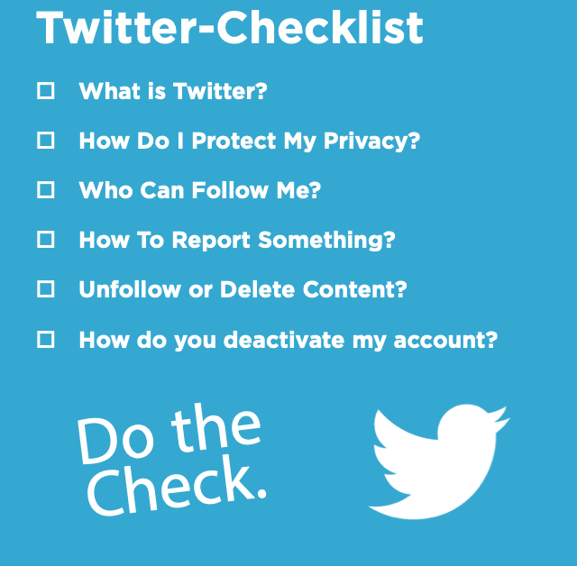






Privacy settings
Notes:
SWGFL have produced parental guides for setting a safe environment for your child

Slide 10
Let your child know they can talk to you about online problems
Notes:
You can only find out about things by engaging.
Remember there was a time when you didn’t know what ‘In the Night garden was’?!

Slide 11
What risks?
Inappropriate content
Free access to pornography
Extremist videos/content
Violent content
Grooming
Spam
Bullying
Notes:
You can only find out about things by engaging.
Remember there was a time when you didn’t know what ‘In the Night garden was’?!

Slide 12
Worried?
Notes:
Quiet, withdrawn, aggressive, sexualized behaviour, lying.
You know your child. Look for signs of difference

Slide 13


Slide 14

Reporting content
ceop.police.uk/safety-centre/

Slide 15
Who can I talk to?
Notes:
Teachers, other parents, websites

Slide 16
Can’t I just stop my kids using it?
Notes:
Nope! The internet is an integral part of modern life and essential for work and personal life.
It’s about appropriate use and resilience and them knowing they can talk to you about any issues they have using it.

Slide 17
Questions

